Slide 1
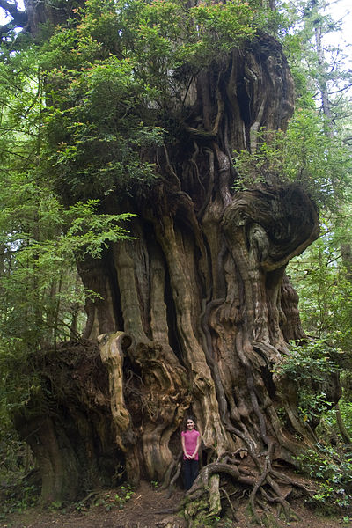
Sight-cedar tree

Slide 2
Write down name of picture-
What does it look like? What do parts of it look like?- twisted, curvy, old man, eye, snakes
What does it remind you of? Animals living in hundred acre wood- Winnie the Pooh, Hobbits, fairies, lord of the rings, butze, childhood, climbing trees
Does it make you think of any action words (verbs)? Slithering, crawling, evil

Slide 3
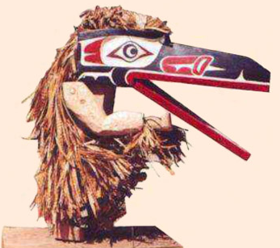
Sight- Raven mask

Slide 4
Write down name of picture-
What does it look like? What do parts of it look like?
What does it remind you of?
Does it make you think of any action words (verbs)?

Slide 5
Sight-art/bear

Slide 6
Write down name of picture-
What does it look like? What do parts of it look like?
What does it remind you of?
Does it make you think of any action words (verbs)?

Slide 7
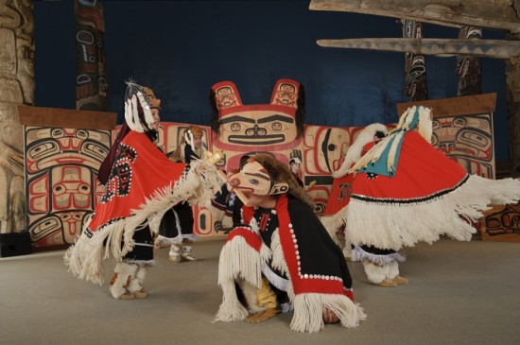
Sight- Traditional dancing

Slide 8
Write down name of picture-
What does it look like? What do parts of it look like?
What does it remind you of?
Does it make you think of any action words (verbs)?

Slide 9
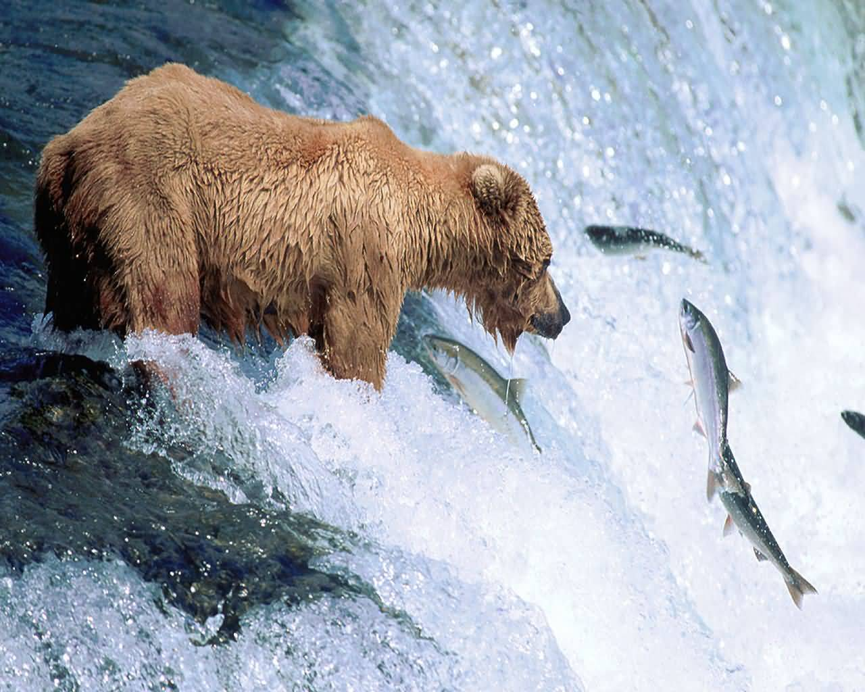
Sight- grizzly fishing

Slide 10
Write down name of picture-
What does it look like? What do parts of it look like?
What does it remind you of?
Does it make you think of any action words (verbs)?

Slide 11
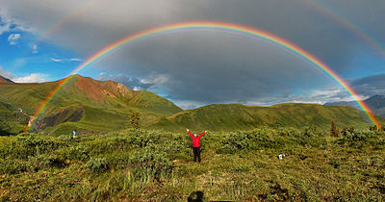
Sight-rainbow

Slide 12
Write down name of picture-
What does it look like? What do parts of it look like?
What does it remind you of?
Does it make you think of any action words (verbs)?

Slide 13
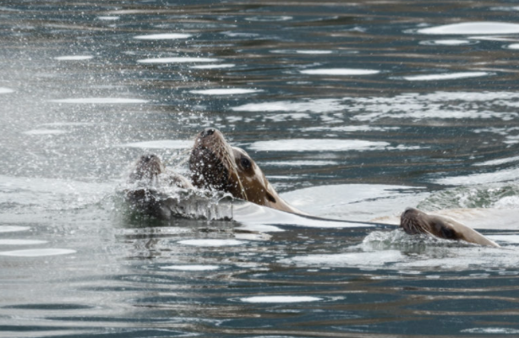
Sight- Seals in the Skeena

Slide 14
Write down name of picture-
What does it look like? What do parts of it look like?
What does it remind you of?
Does it make you think of any action words (verbs)?

Slide 15
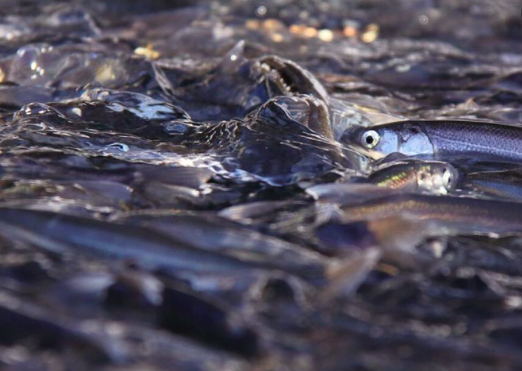
Sight- Oolichan Run

Slide 16
Write down name of picture-
What does it look like? What do parts of it look like?
What does it remind you of?
Does it make you think of any action words (verbs)?

Slide 17
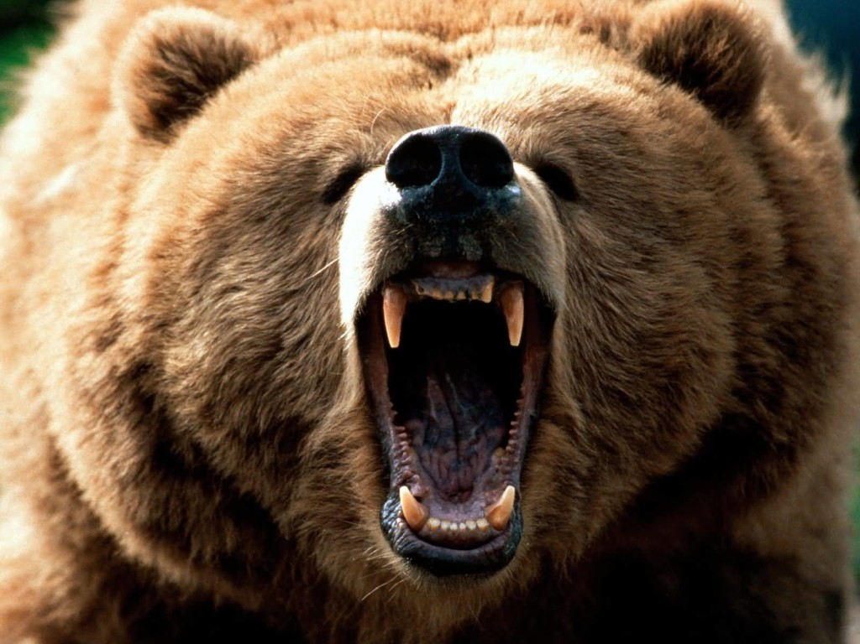
Sound-bear
http://www.youtube.com/watch?v=YexQcXnVSzg

Slide 18
Write down name of picture-
What does it sound like? What did parts of it sound like?
What does it remind you of?
Does it make you think of any action words (verbs)?

Slide 19
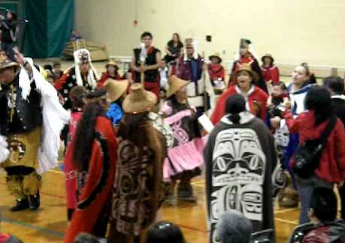
Sound-Dancers
https://www.youtube.com/watch?v=6-OieGqK3a0

Slide 20
Write down name of picture-
What does it sound like? What did parts of it sound like?
What does it remind you of?
Does it make you think of any action words (verbs)?

Slide 21
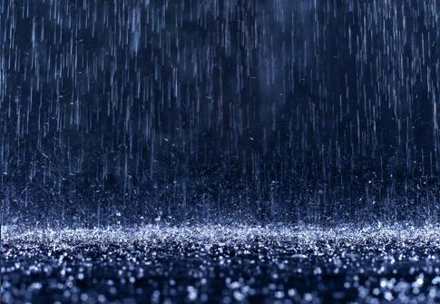
Sound-rain
http://www.youtube.com/watch?v=jX6kn9_U8qk

Slide 22
Write down name of picture-
What does it sound like? What did parts of it sound like?
What does it remind you of?
Does it make you think of any action words (verbs)?

Slide 23
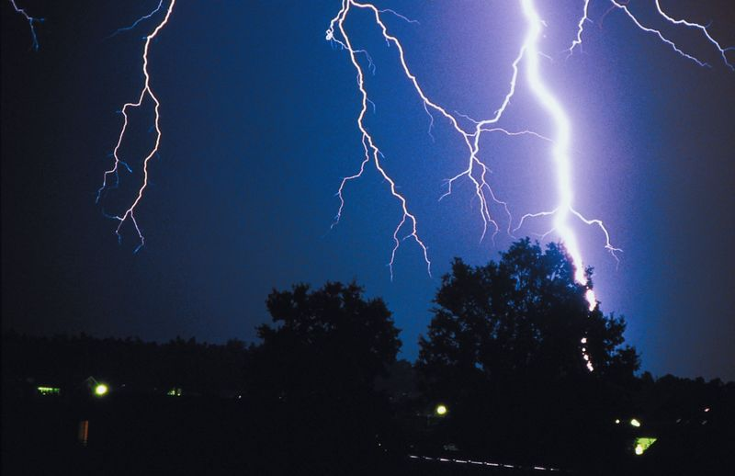
Sound-thunder
http://www.youtube.com/watch?v=mQ9OWMsJBTk

Slide 24
Write down name of picture-
What does it sound like? What did parts of it sound like?
What does it remind you of?
Does it make you think of any action words (verbs)?

Slide 25
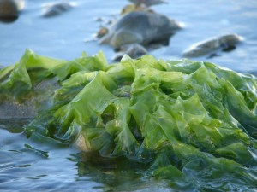
Touch- kelp/seaweed

Slide 26
Write down name of picture-
What does it feel like? What do parts of it feel like?
What does it remind you of?
Does it make you think of any action words (verbs)?

Slide 27
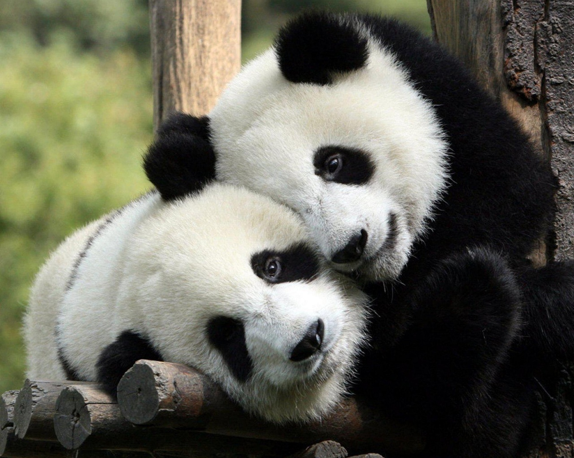
Touch-hug

Slide 28
Write down name of picture-
What does it feel like? What do parts of it feel like?
What does it remind you of?
Does it make you think of any action words (verbs)?

Slide 29
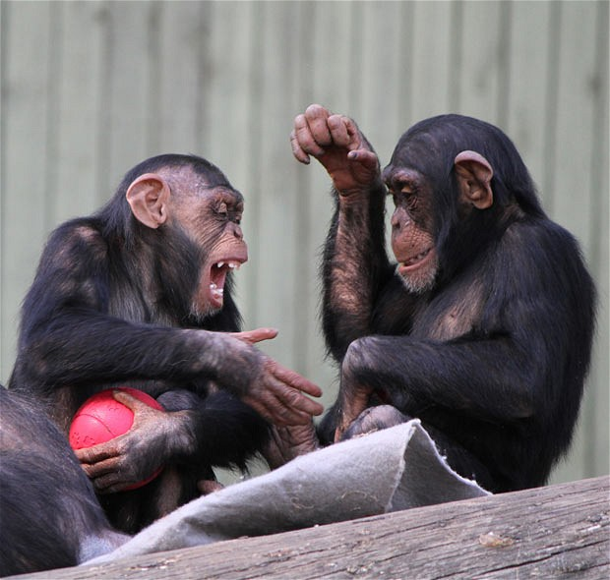
Touch-handshake

Slide 30
Write down name of picture-
What does it feel like? What do parts of it feel like?
What does it remind you of?
Does it make you think of any action words (verbs)?

Slide 31
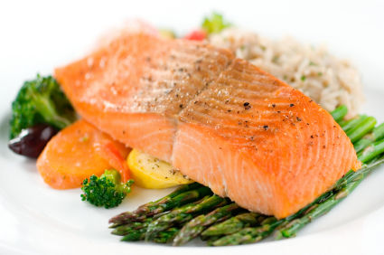
Taste-salmon

Slide 32
Write down name of picture-
What does it taste like? What do parts of it taste like?
What does it remind you of?
Does it make you think of any action words (verbs)?

Slide 33
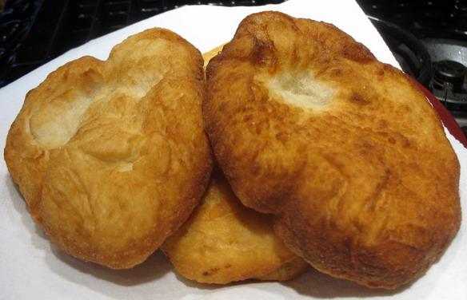
Taste-fried bread

Slide 34
Write down name of picture-
What does it taste like? What do parts of it taste like?
What does it remind you of?
Does it make you think of any action words (verbs)?

Slide 35
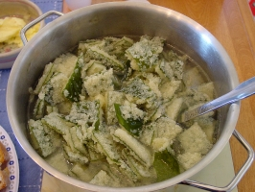
Taste-herring eggs

Slide 36
Write down name of picture-
What does it taste like? What do parts of it taste like?
What does it remind you of?
Does it make you think of any action words (verbs)?

Slide 37
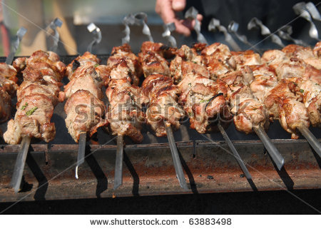
Smell-shishkebab

Slide 38
Write down name of picture-
What does it smell like? What do parts of it smell like?
What does the smell remind you of?
Does it make you think of any action words (verbs)?

Slide 39
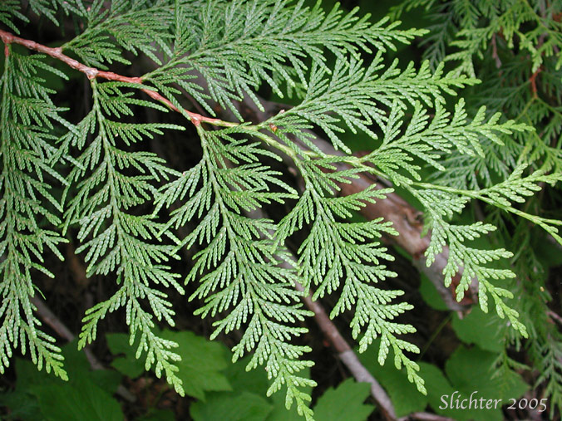
Smell-cedar branch

Slide 40
Write down name of picture-
What does it smell like? What do parts of it smell like?
What does the smell remind you of?
Does it make you think of any action words (verbs)?

Slide 41
Smell-fry bread

Slide 42
Write down name of picture-
What does it smell like? What do parts of it smell like?
What does the smell remind you of?
Does it make you think of any action words (verbs)?

