Slide 1
INDIGENOUS CHRISTMAS
ADVENT CALENDAR
WITH LINKS TO FUN
SONGS & VIDEOS

Slide 2
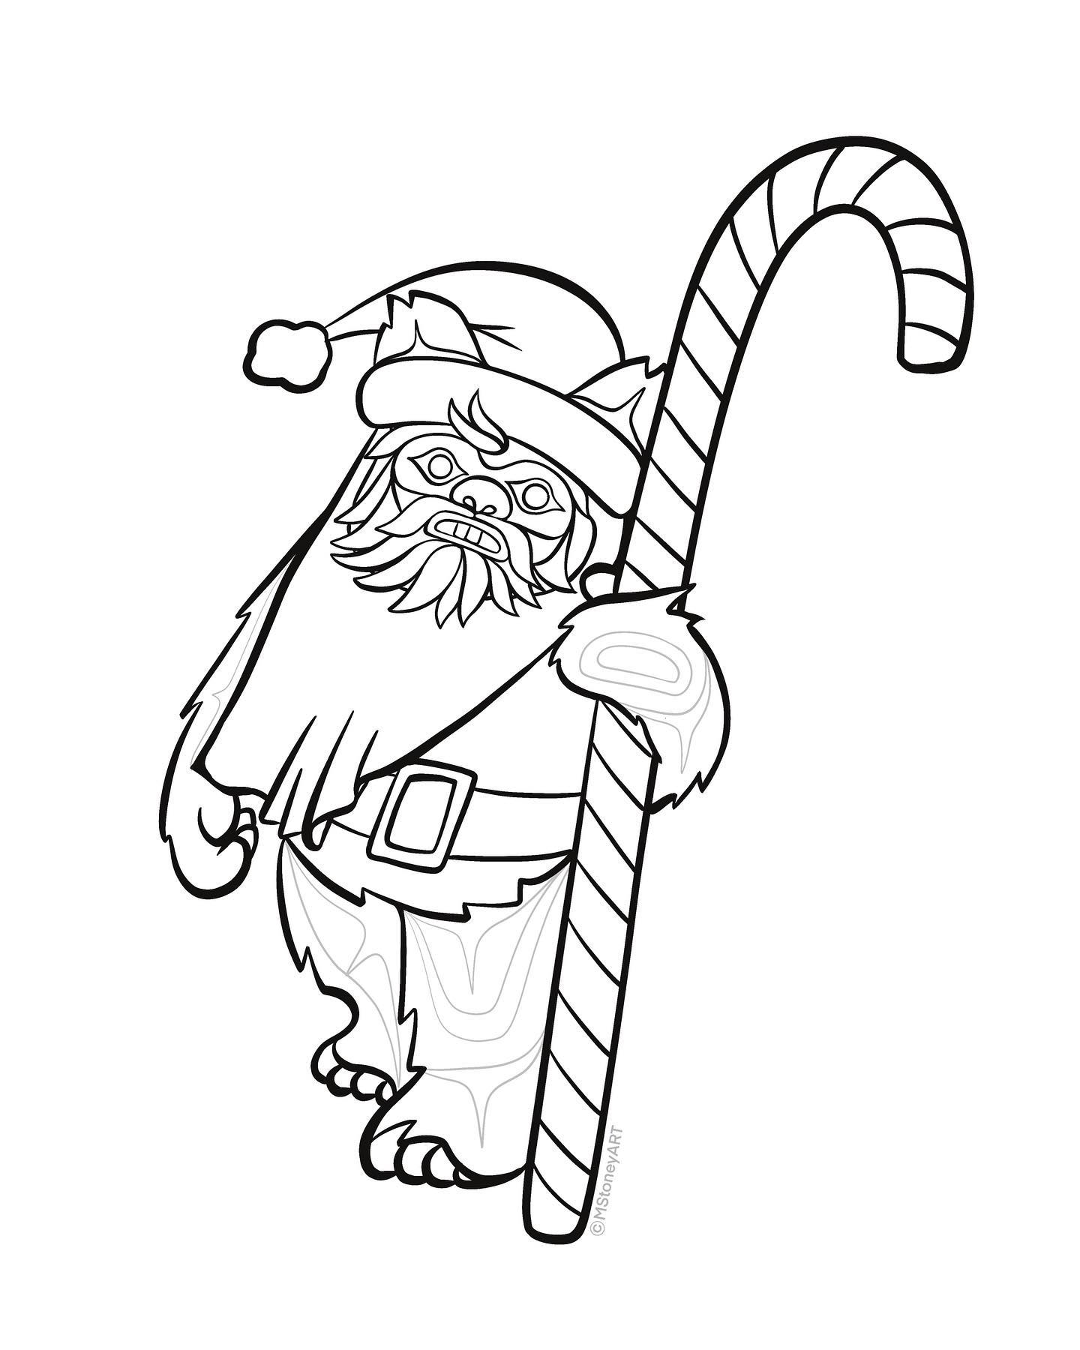
Advent Calendar
Day 1 - Click on the picture for a fun surprise
All Artwork in this power point has been created by Gitxsan Artist Michelle Stoney and is being used with permission. This is only to be used for educational purposes and not for profit. Click on the logo for more information on the artist.

Slide 3
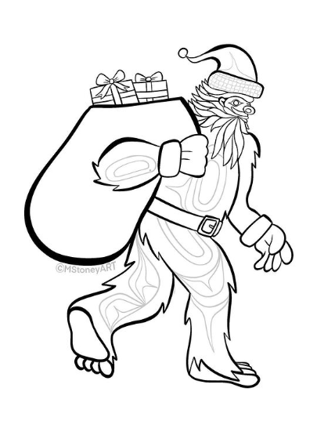
2
Advent Calendar
Day 2 - Click on the picture for a fun surprise
All Artwork in this power point has been created by Gitxsan Artist Michelle Stoney and is being used with permission. This is only to be used for educational purposes and not for profit. Click on the logo for more information on the artist.

Slide 4
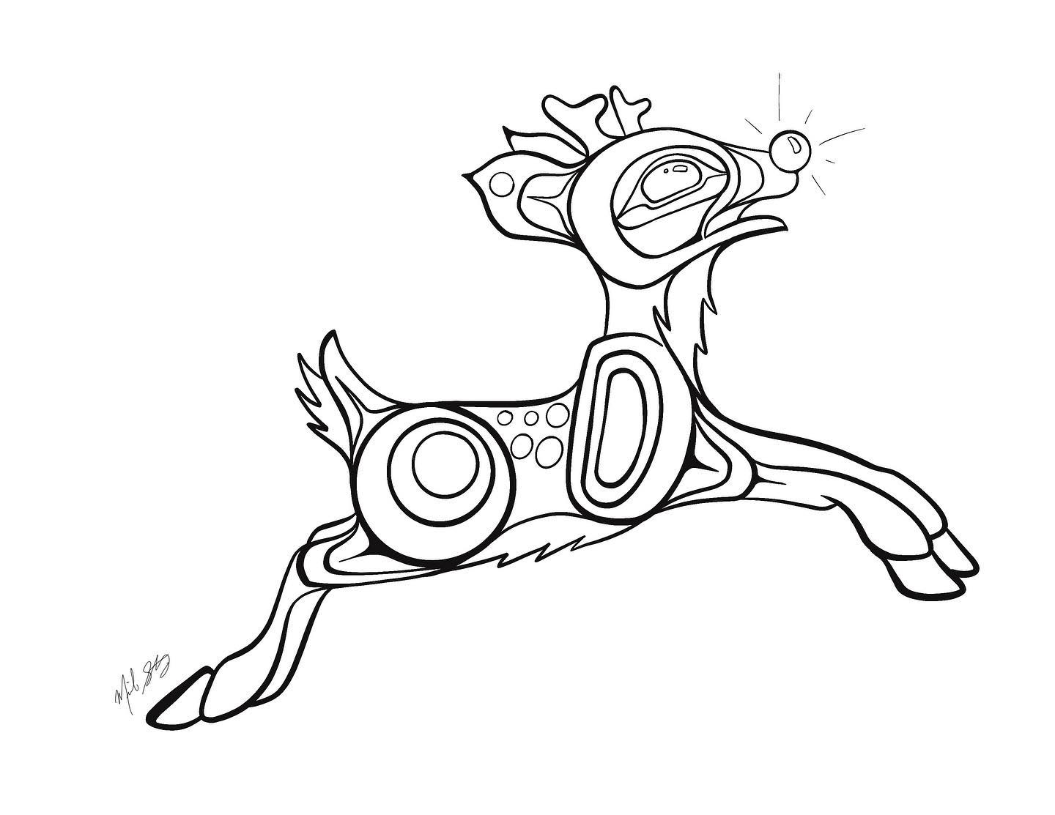
3
Advent Calendar
Day 3 - Click on the picture for a fun surprise
All Artwork in this power point has been created by Gitxsan Artist Michelle Stoney and is being used with permission. This is only to be used for educational purposes and not for profit. Click on the logo for more information on the artist.

Slide 5
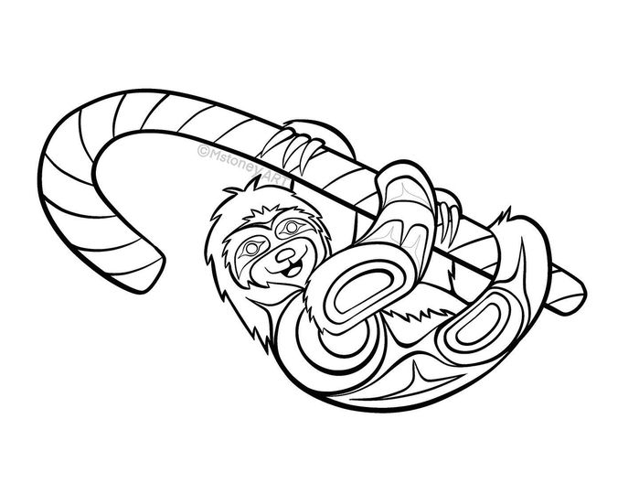
4
Advent Calendar
Day 4 - Click on the picture for a fun surprise
All Artwork in this power point has been created by Gitxsan Artist Michelle Stoney and is being used with permission. This is only to be used for educational purposes and not for profit. Click on the logo for more information on the artist.

Slide 6
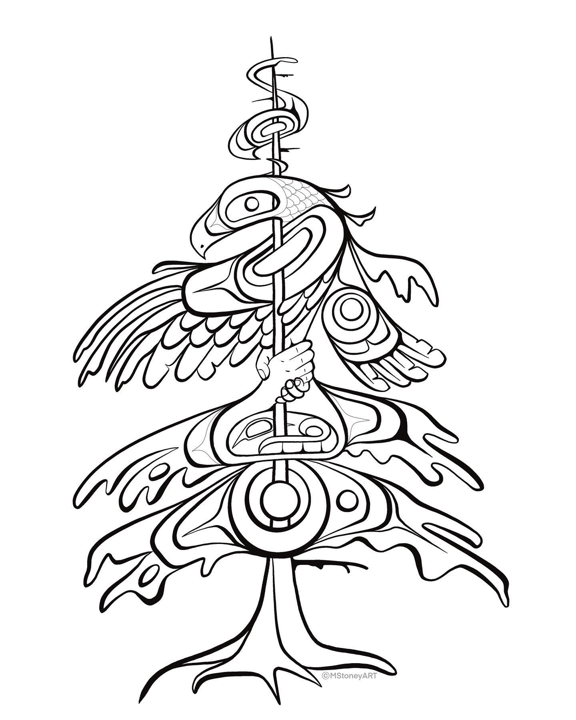
5
Advent Calendar
Day 5 - Click on the picture for a fun surprise
All Artwork in this power point has been created by Gitxsan Artist Michelle Stoney and is being used with permission. This is only to be used for educational purposes and not for profit. Click on the logo for more information on the artist.

Slide 7
6
Advent Calendar
Day 6 - Click on the picture for a fun surprise
All Artwork in this power point has been created by Gitxsan Artist Michelle Stoney and is being used with permission. This is only to be used for educational purposes and not for profit. Click on the logo for more information on the artist.

Slide 8
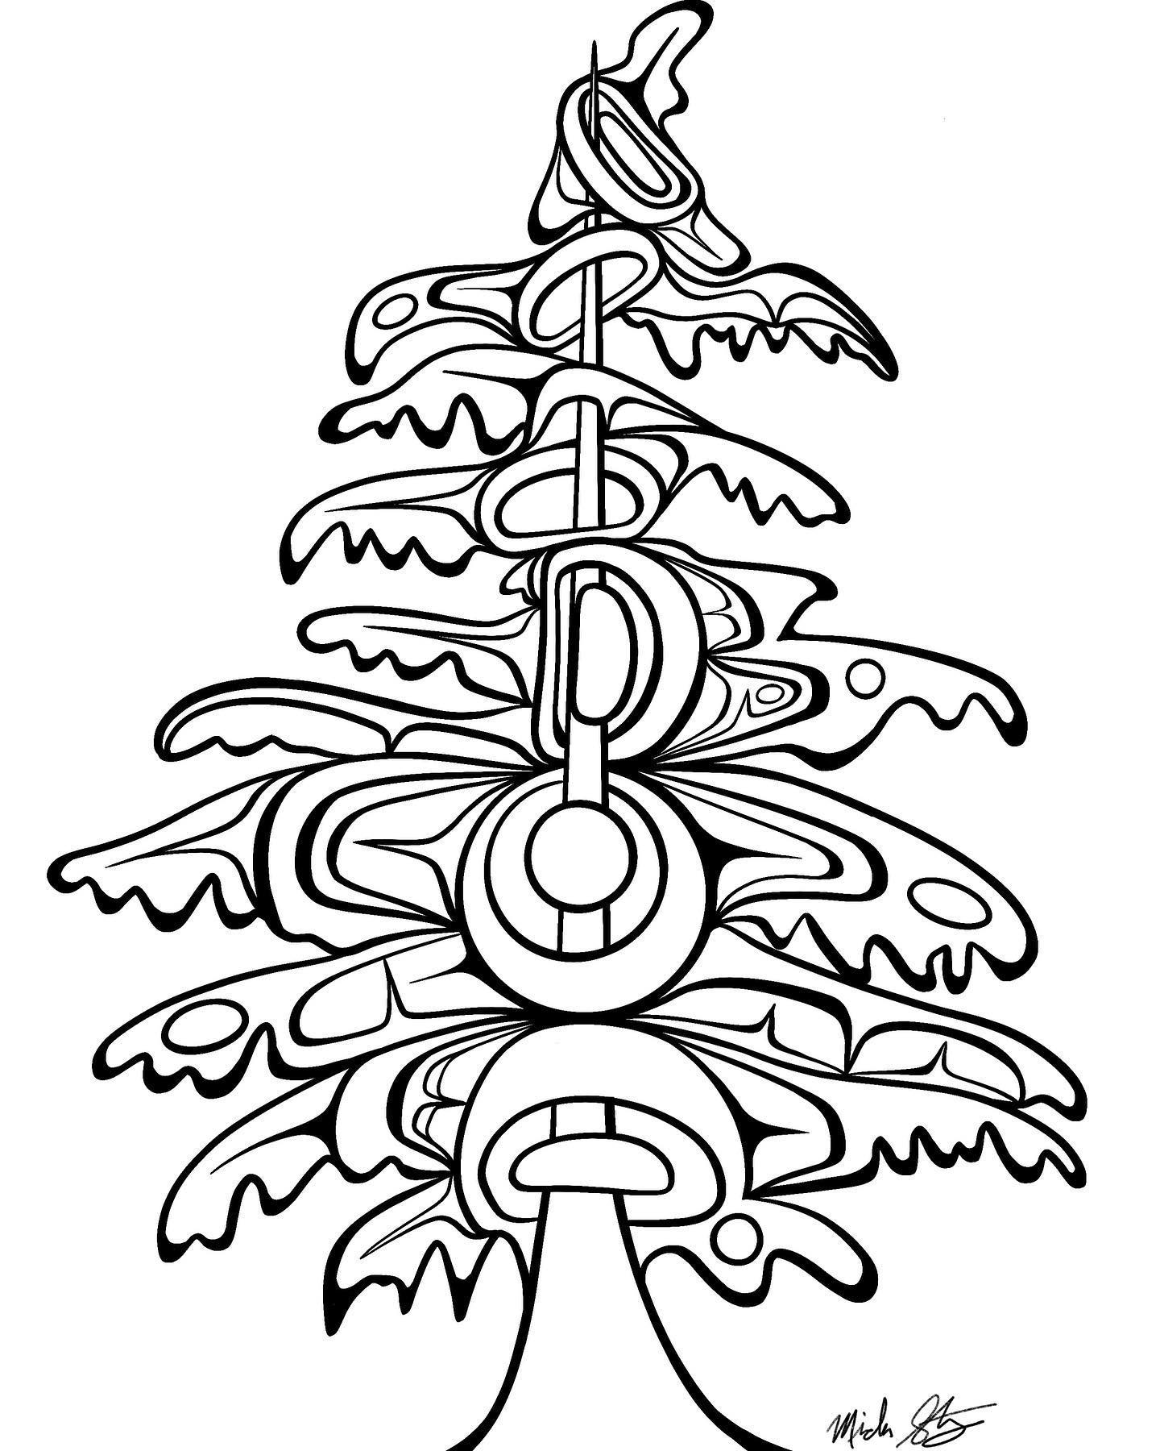
7
Advent Calendar
Day 7 - Click on the picture for a fun surprise
All Artwork in this power point has been created by Gitxsan Artist Michelle Stoney and is being used with permission. This is only to be used for educational purposes and not for profit. Click on the logo for more information on the artist.

Slide 9
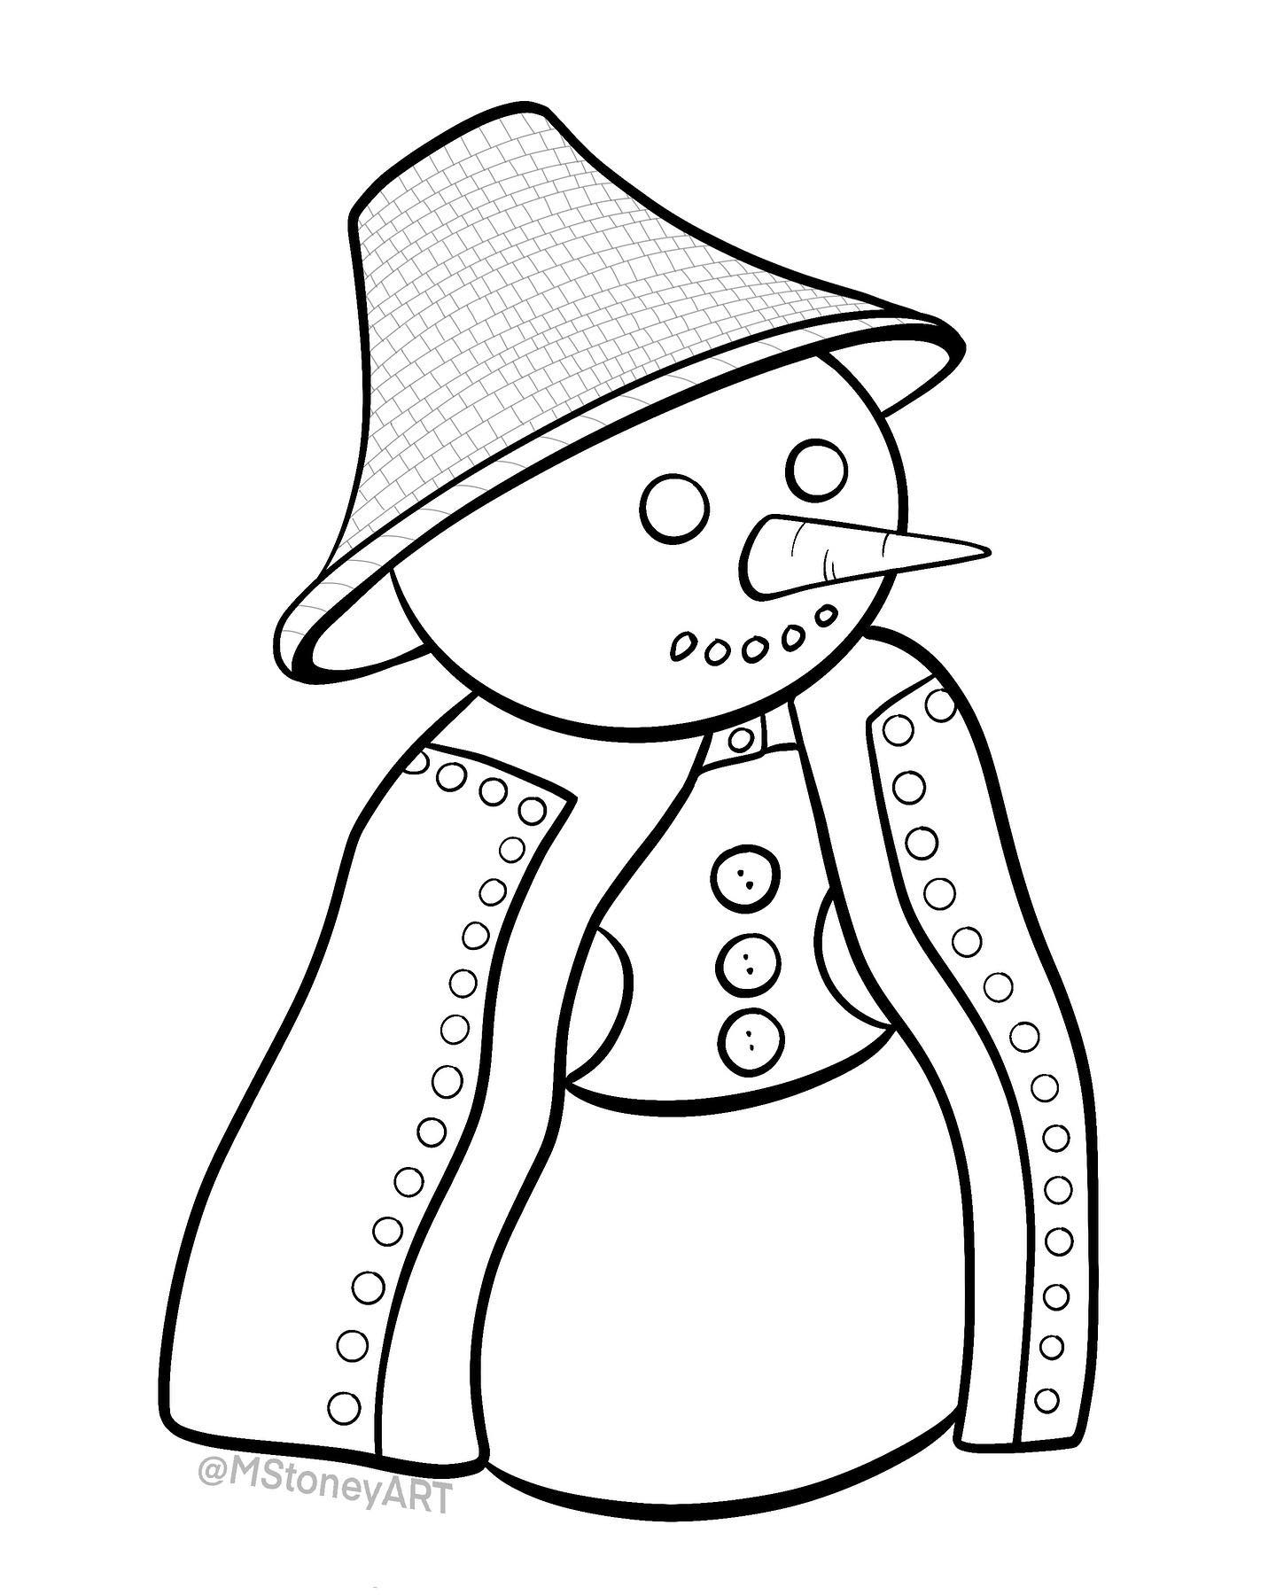
8
Advent Calendar
Day 8 - Click on the picture for a fun surprise
All Artwork in this power point has been created by Gitxsan Artist Michelle Stoney and is being used with permission. This is only to be used for educational purposes and not for profit. Click on the logo for more information on the artist.

Slide 10
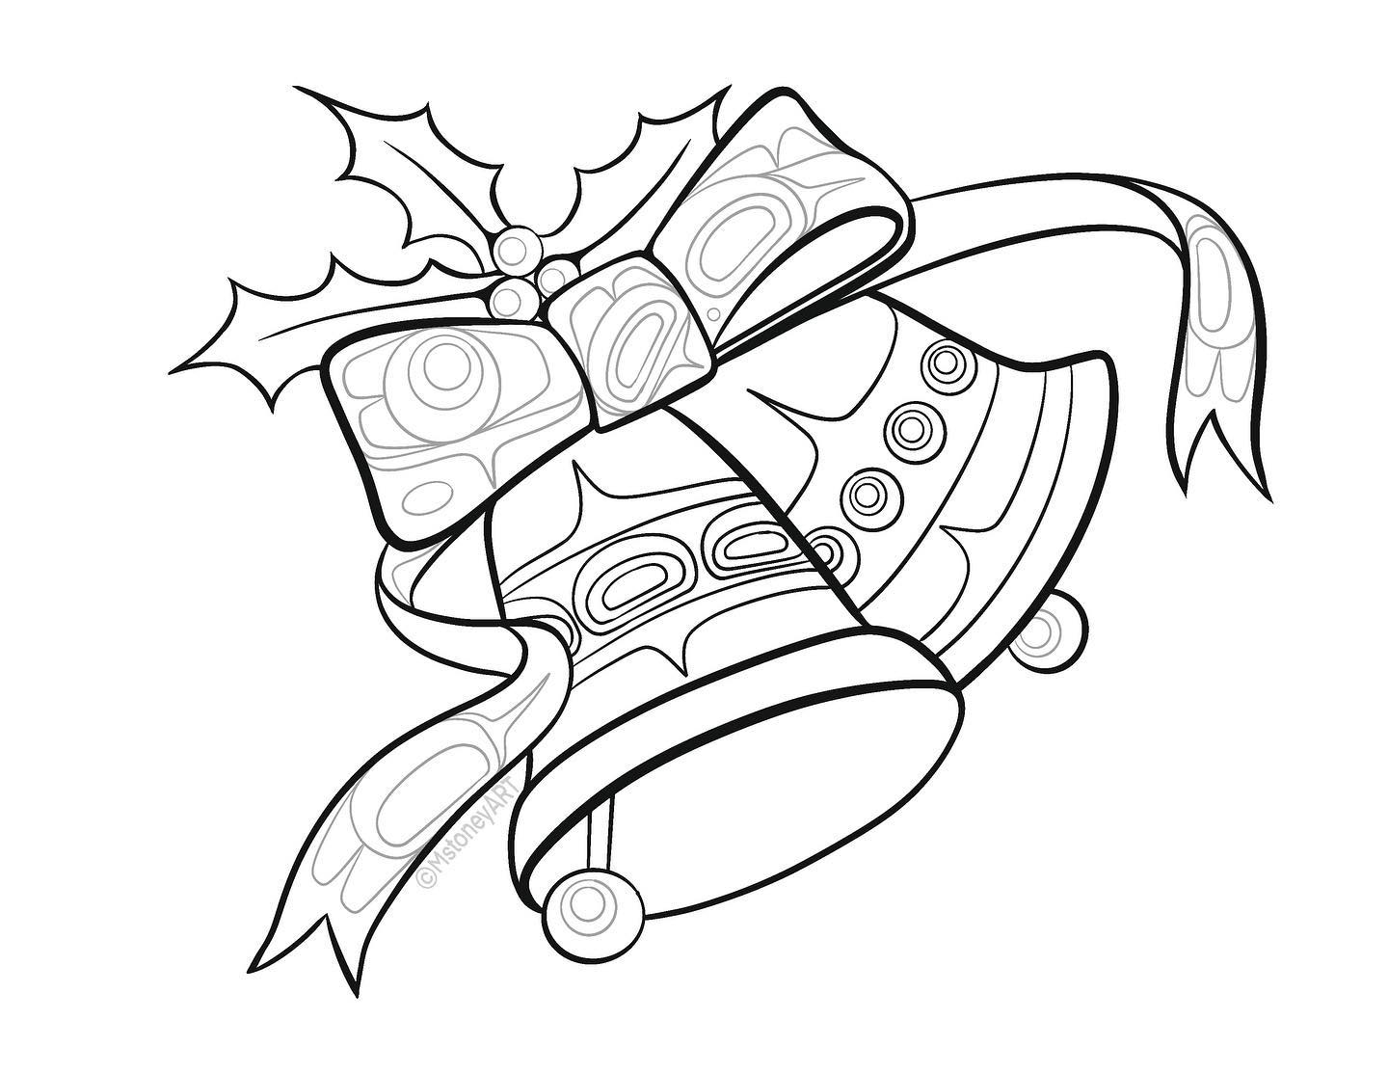
9
Advent Calendar
Day 9 - Click on the picture for a fun surprise
All Artwork in this power point has been created by Gitxsan Artist Michelle Stoney and is being used with permission. This is only to be used for educational purposes and not for profit. Click on the logo for more information on the artist.

Slide 11
10
Advent Calendar
Day 10 - Click on the picture for a fun surprise
All Artwork in this power point has been created by Gitxsan Artist Michelle Stoney and is being used with permission. This is only to be used for educational purposes and not for profit. Click on the logo for more information on the artist.

Slide 12
11
Advent Calendar
Day 11 - Click on the picture for a fun surprise
All Artwork in this power point has been created by Gitxsan Artist Michelle Stoney and is being used with permission. This is only to be used for educational purposes and not for profit. Click on the logo for more information on the artist.

Slide 13
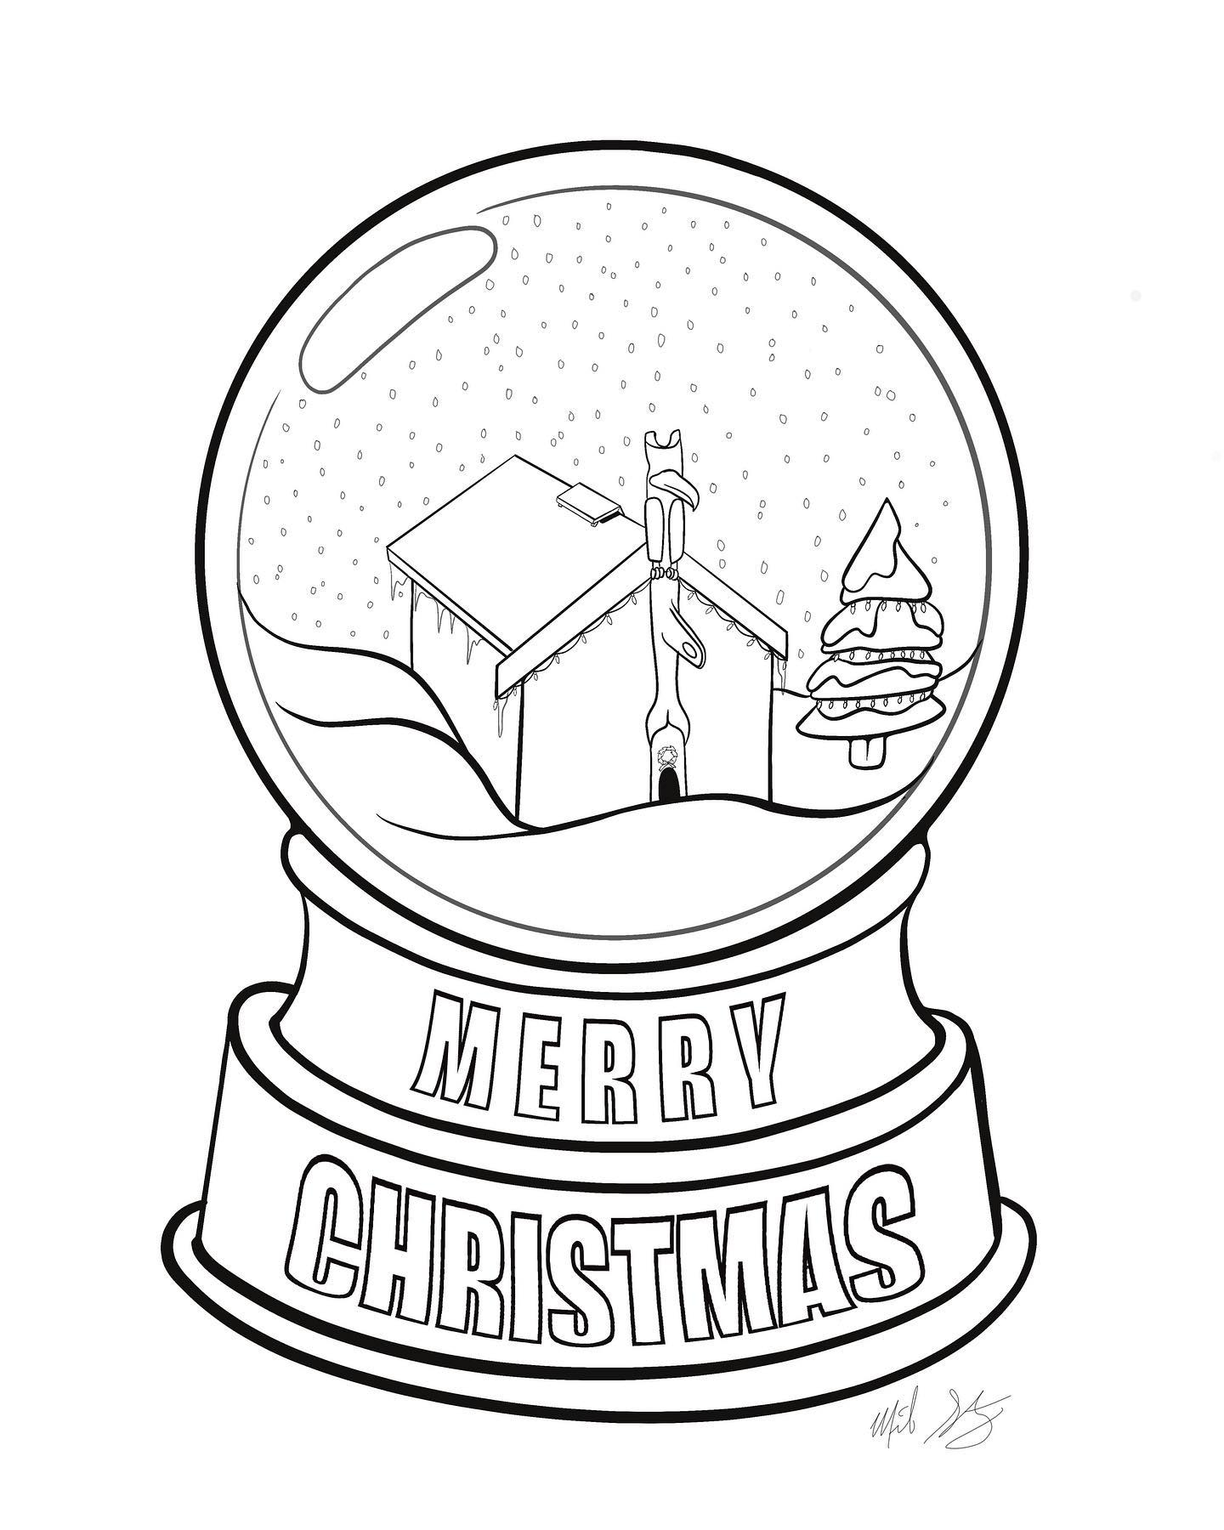
12
Advent Calendar
Day 12 - Click on the picture for a fun surprise
All Artwork in this power point has been created by Gitxsan Artist Michelle Stoney and is being used with permission. This is only to be used for educational purposes and not for profit. Click on the logo for more information on the artist.

Slide 14
13
Advent Calendar
Day 13 - Click on the picture for a fun surprise
All Artwork in this power point has been created by Gitxsan Artist Michelle Stoney and is being used with permission. This is only to be used for educational purposes and not for profit. Click on the logo for more information on the artist.

Slide 15
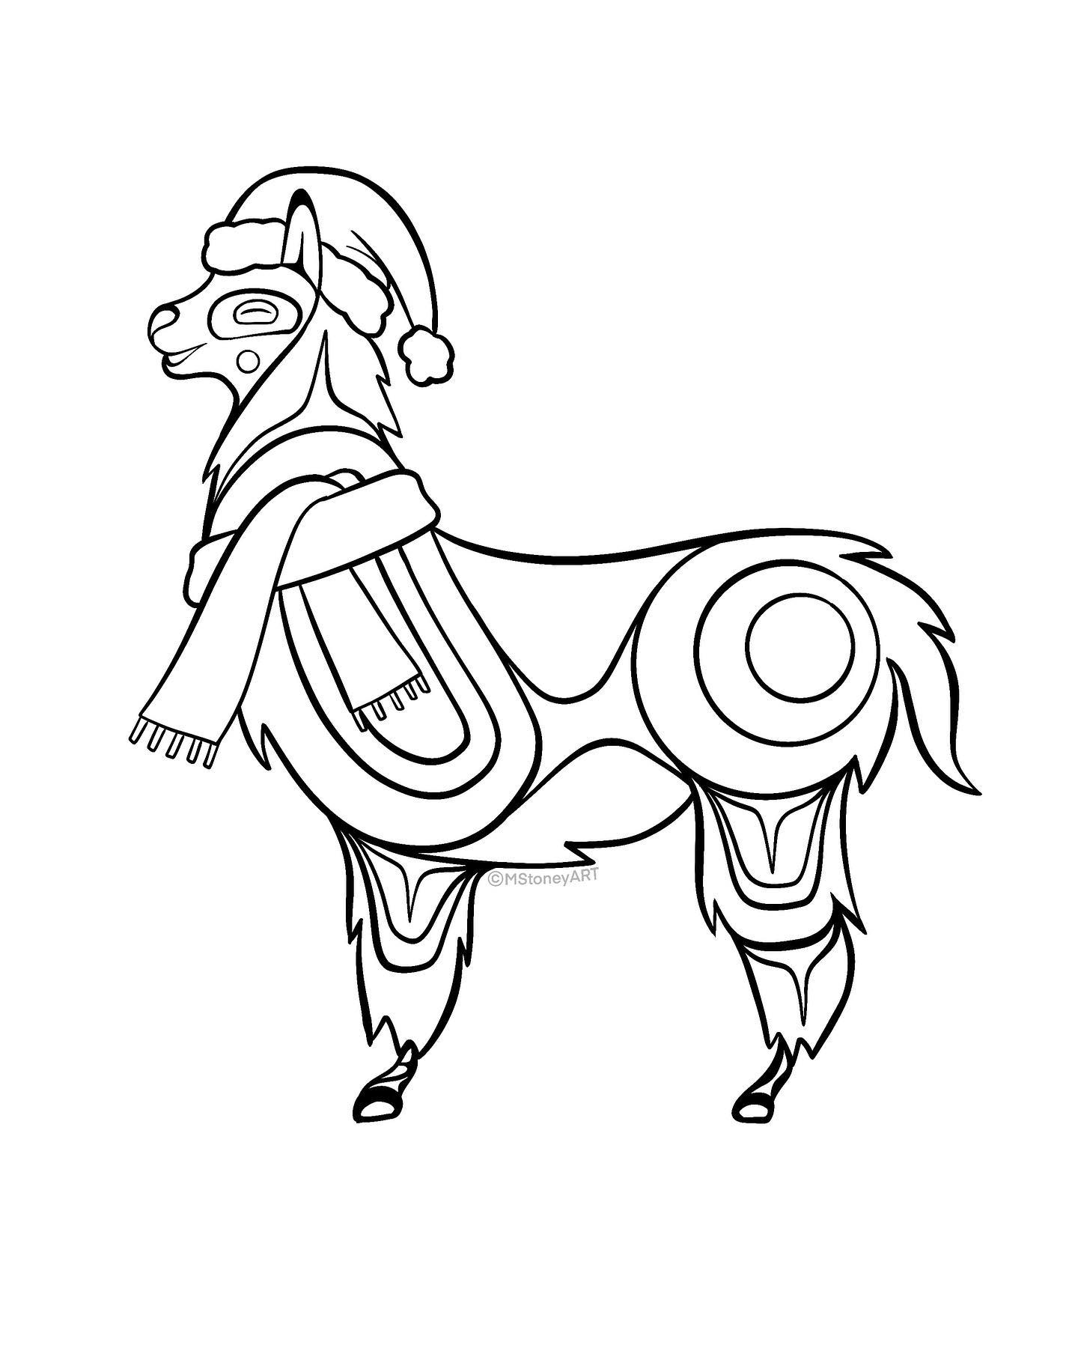
14
Advent Calendar
Day 14 - Click on the picture for a fun surprise
All Artwork in this power point has been created by Gitxsan Artist Michelle Stoney and is being used with permission. This is only to be used for educational purposes and not for profit. Click on the logo for more information on the artist.

Slide 16
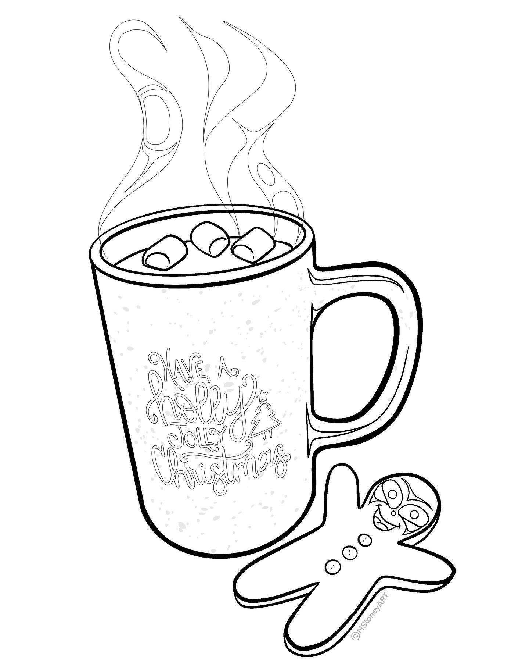
15
Advent Calendar
Day 15 - Click on the picture for a fun surprise
All Artwork in this power point has been created by Gitxsan Artist Michelle Stoney and is being used with permission. This is only to be used for educational purposes and not for profit. Click on the logo for more information on the artist.

Slide 17
16
Advent Calendar
Day 16 - Click on the picture for a fun surprise
All Artwork in this power point has been created by Gitxsan Artist Michelle Stoney and is being used with permission. This is only to be used for educational purposes and not for profit. Click on the logo for more information on the artist.

Slide 18
17
Advent Calendar
Day 17 - Click on the picture for a fun surprise
All Artwork in this power point has been created by Gitxsan Artist Michelle Stoney and is being used with permission. This is only to be used for educational purposes and not for profit. Click on the logo for more information on the artist.

Slide 19
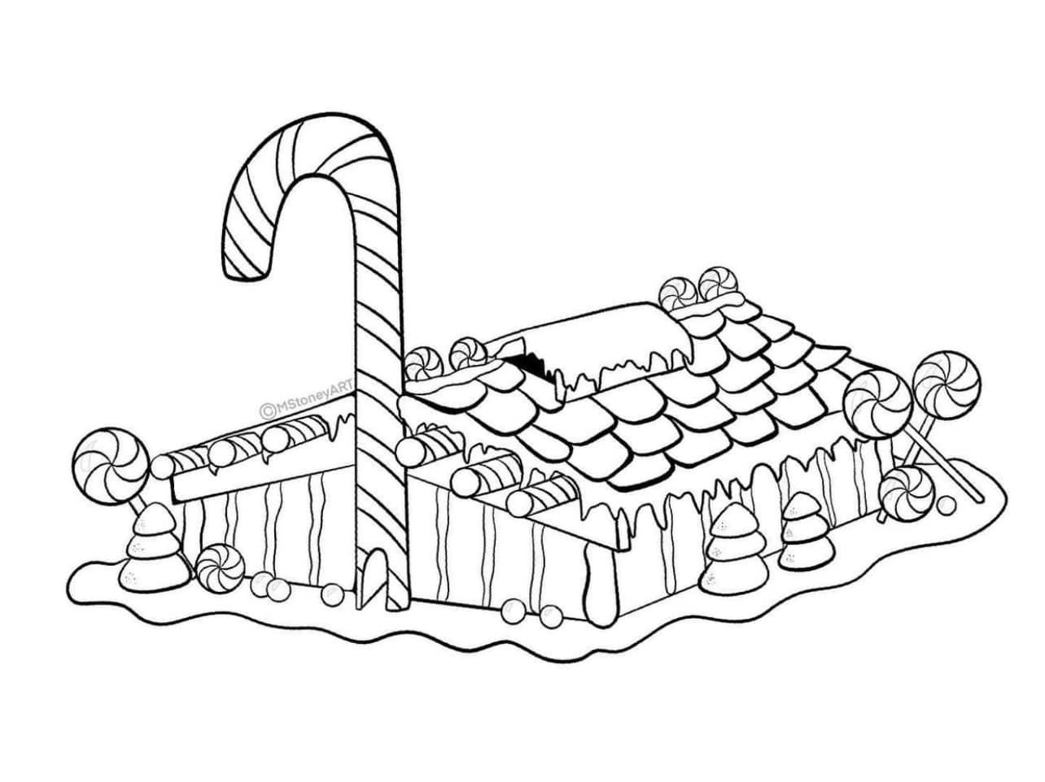
18
Advent Calendar
Day 18 - Click on the picture for a fun surprise
All Artwork in this power point has been created by Gitxsan Artist Michelle Stoney and is being used with permission. This is only to be used for educational purposes and not for profit. Click on the logo for more information on the artist.

Slide 20
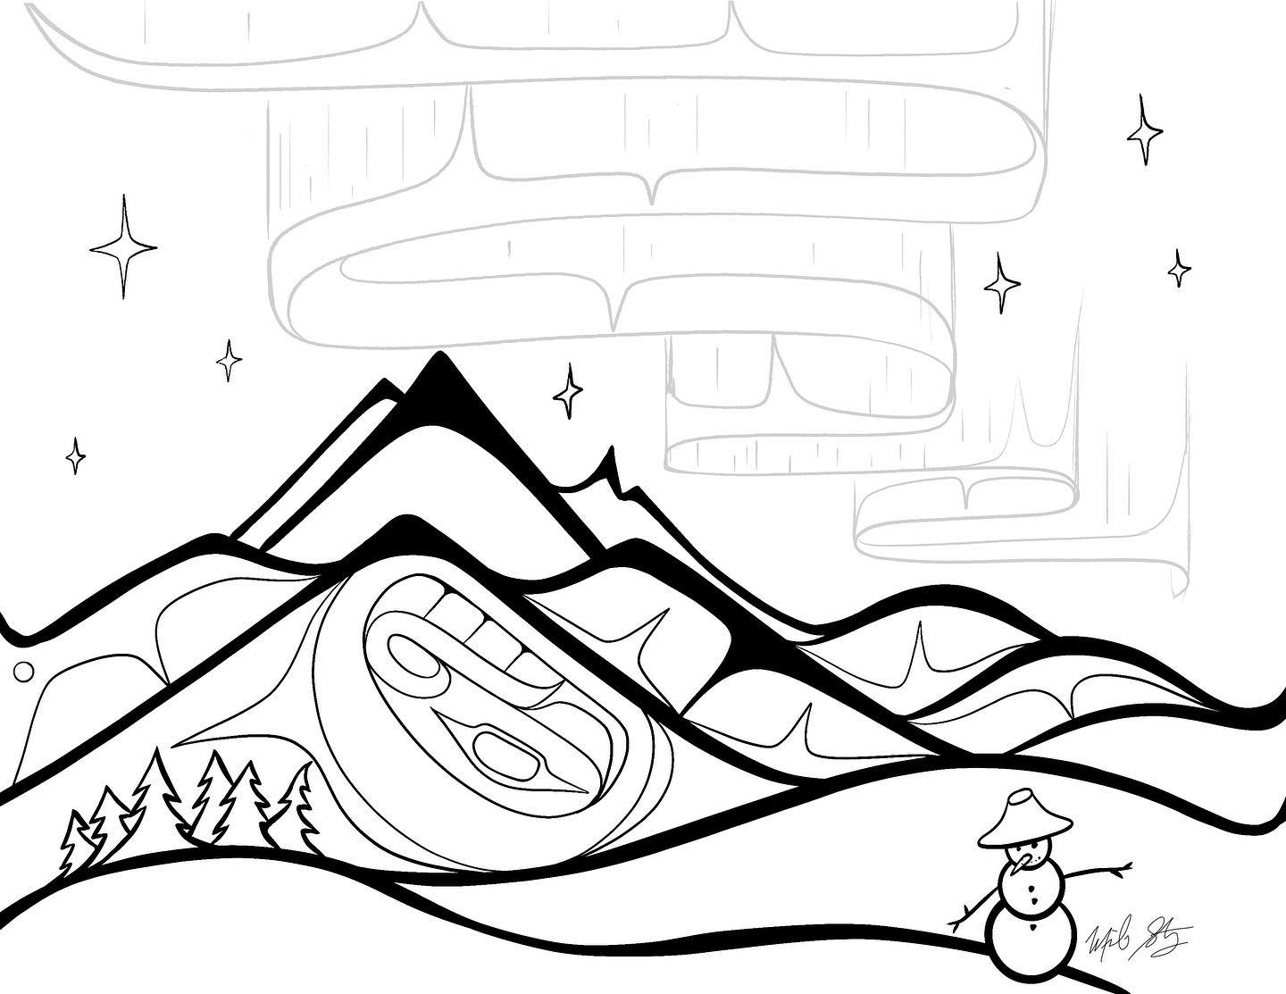
19
Advent Calendar
Day 19 - Click on the picture for a fun surprise
All Artwork in this power point has been created by Gitxsan Artist Michelle Stoney and is being used with permission. This is only to be used for educational purposes and not for profit. Click on the logo for more information on the artist.

Slide 21
20
Advent Calendar
Day 20 - Click on the picture for a fun surprise
All Artwork in this power point has been created by Gitxsan Artist Michelle Stoney and is being used with permission. This is only to be used for educational purposes and not for profit. Click on the logo for more information on the artist.

Slide 22
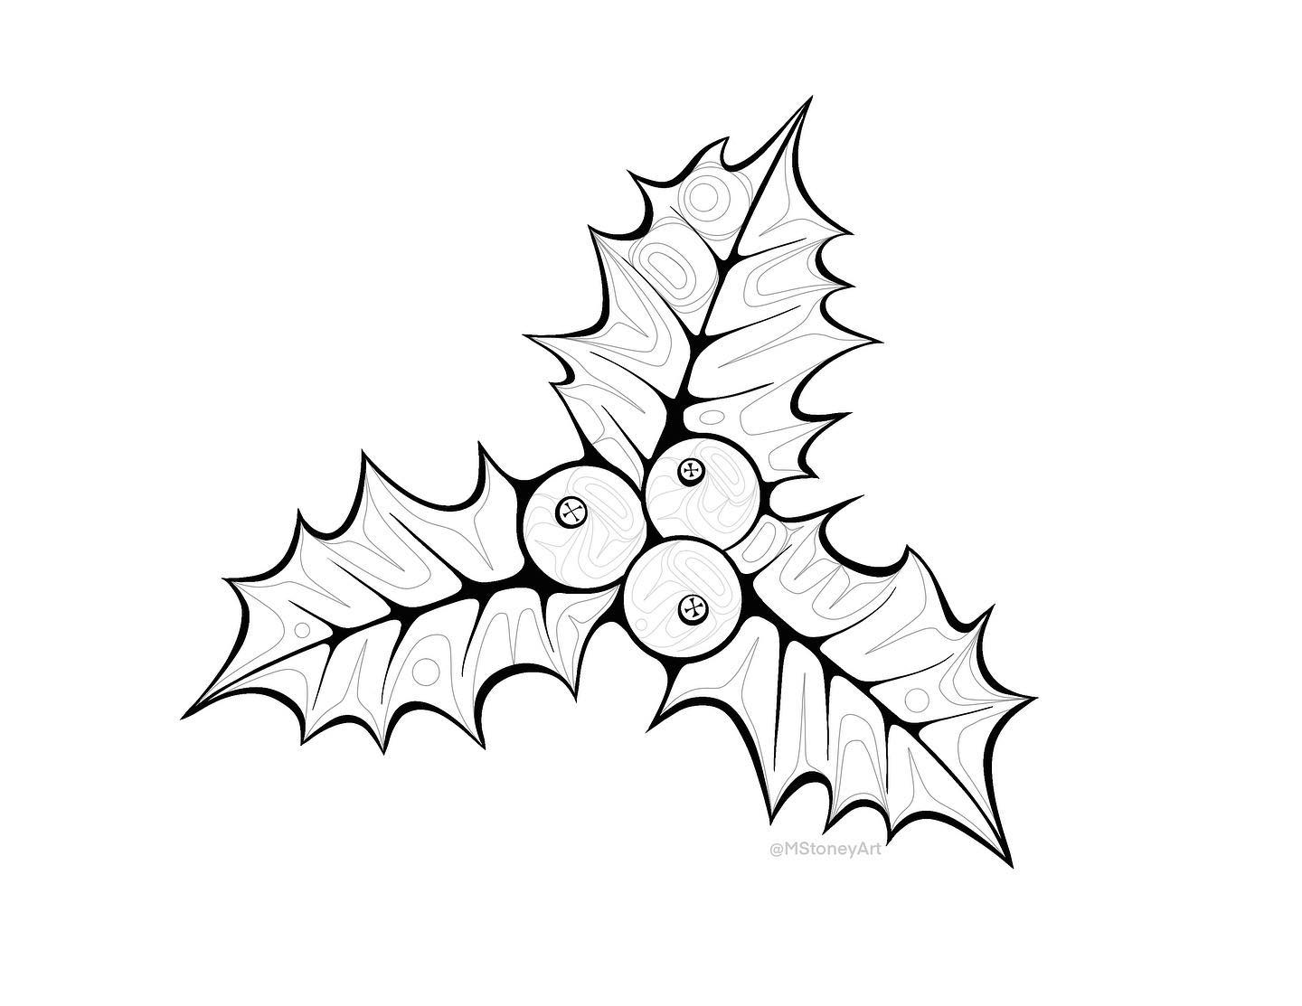
21
Advent Calendar
Day 21 - Click on the picture for a fun surprise
All Artwork in this power point has been created by Gitxsan Artist Michelle Stoney and is being used with permission. This is only to be used for educational purposes and not for profit. Click on the logo for more information on the artist.

Slide 23
22
Advent Calendar
Day 22 - Click on the picture for a fun surprise
All Artwork in this power point has been created by Gitxsan Artist Michelle Stoney and is being used with permission. This is only to be used for educational purposes and not for profit. Click on the logo for more information on the artist.

Slide 24
23
Advent Calendar
Day 23 - Click on the picture for a fun surprise
All Artwork in this power point has been created by Gitxsan Artist Michelle Stoney and is being used with permission. This is only to be used for educational purposes and not for profit. Click on the logo for more information on the artist.

Slide 25
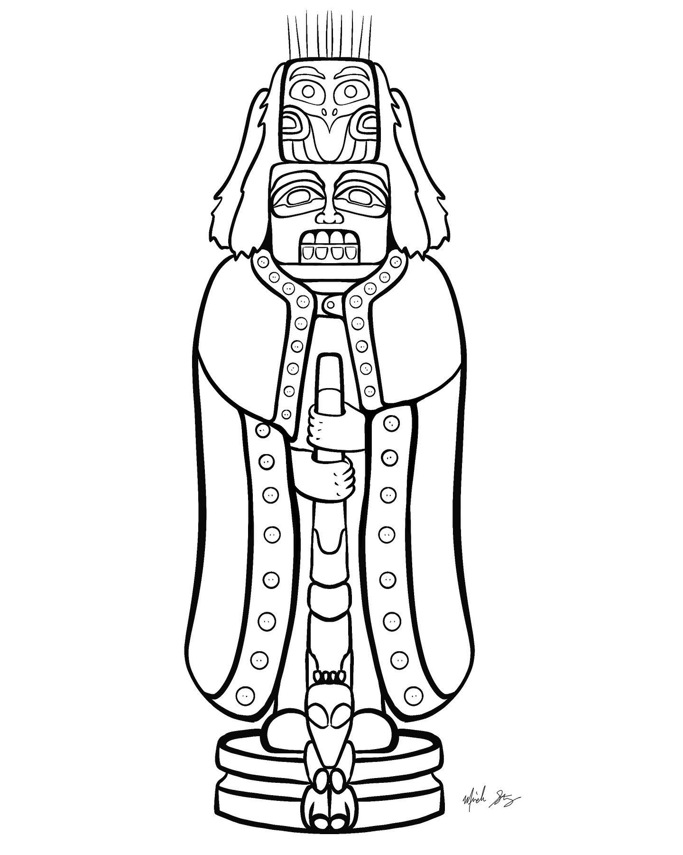
24
Advent Calendar
Day 24 - Click on the picture for a fun surprise
All Artwork in this power point has been created by Gitxsan Artist Michelle Stoney and is being used with permission. This is only to be used for educational purposes and not for profit. Click on the logo for more information on the artist.

Slide 26
25
Advent Calendar
Day 25 - Click on the picture for a fun surprise
All Artwork in this power point has been created by Gitxsan Artist Michelle Stoney and is being used with permission. This is only to be used for educational purposes and not for profit. Click on the logo for more information on the artist.

Slide 27
https://aashley.weebly.com/indigenous-christmas-fun.html
Stuck In The Smoke Hole Of Our Tipi: Shoshone Christmas Song - Elder Oldhands
Day 2

Slide 28
https://aashley.weebly.com/indigenous-christmas-fun.html
Woodab: Rudolph The Red-Nosed Reindeer - Ojibway Version - Minowakiing Anishinaabemojig
Day 3

Slide 29
https://aashley.weebly.com/indigenous-christmas-fun.html
The Little Drummer Boy: Chief Sheppard Band *Salute Turtle Island Drum Groups
Day 2

Slide 30
https://aashley.weebly.com/indigenous-christmas-fun.html
Winter Wonderland: *Sung In Ojibwe' - Anishinaabemowin - Jana Mashonee
Day 4

Slide 31
Frosty Goon Nini: Frosty The Snowman - *Sung In Anishinaabe - Doopnibii kwe
Day 5

Slide 32
https://aashley.weebly.com/indigenous-christmas-fun.html
Day 6

Slide 33
https://aashley.weebly.com/indigenous-christmas-fun.html
The Grinch with a twist
Day 7

Slide 34
https://aashley.weebly.com/indigenous-christmas-fun.html
All I Want For Christmas Is You: *Sung In Cree - Tammy Rae Lamouche
Day 8

Slide 35
https://aashley.weebly.com/indigenous-christmas-fun.html
The 12 Days Of Christmas: Cree Comedy Version - Northern Cree & War Scout
Day 9

Slide 36
https://aashley.weebly.com/indigenous-christmas-fun.html
Day 10

Slide 37
https://aashley.weebly.com/indigenous-christmas-fun.html
Day 11

Slide 38
https://aashley.weebly.com/indigenous-christmas-fun.html
Day 12

Slide 39
https://aashley.weebly.com/indigenous-christmas-fun.html
Day 13

Slide 40
https://aashley.weebly.com/indigenous-christmas-fun.html
Day 14

Slide 41
https://aashley.weebly.com/indigenous-christmas-fun.html
Day 15

Slide 42
https://aashley.weebly.com/indigenous-christmas-fun.html
Day 16

Slide 43
https://aashley.weebly.com/indigenous-christmas-fun.html
Day 17

Slide 44
https://aashley.weebly.com/indigenous-christmas-fun.html
Day 18

Slide 45
https://aashley.weebly.com/indigenous-christmas-fun.html
Day 19

Slide 46
https://aashley.weebly.com/indigenous-christmas-fun.html
Day 20

Slide 47
https://aashley.weebly.com/indigenous-christmas-fun.html
Day 21

Slide 48
https://aashley.weebly.com/indigenous-christmas-fun.html
Day 22

Slide 49
https://aashley.weebly.com/indigenous-christmas-fun.html
Day 23

Slide 50
https://aashley.weebly.com/indigenous-christmas-fun.html
Day 24

Slide 51
https://aashley.weebly.com/indigenous-christmas-fun.html
Day 25

